Slide 1
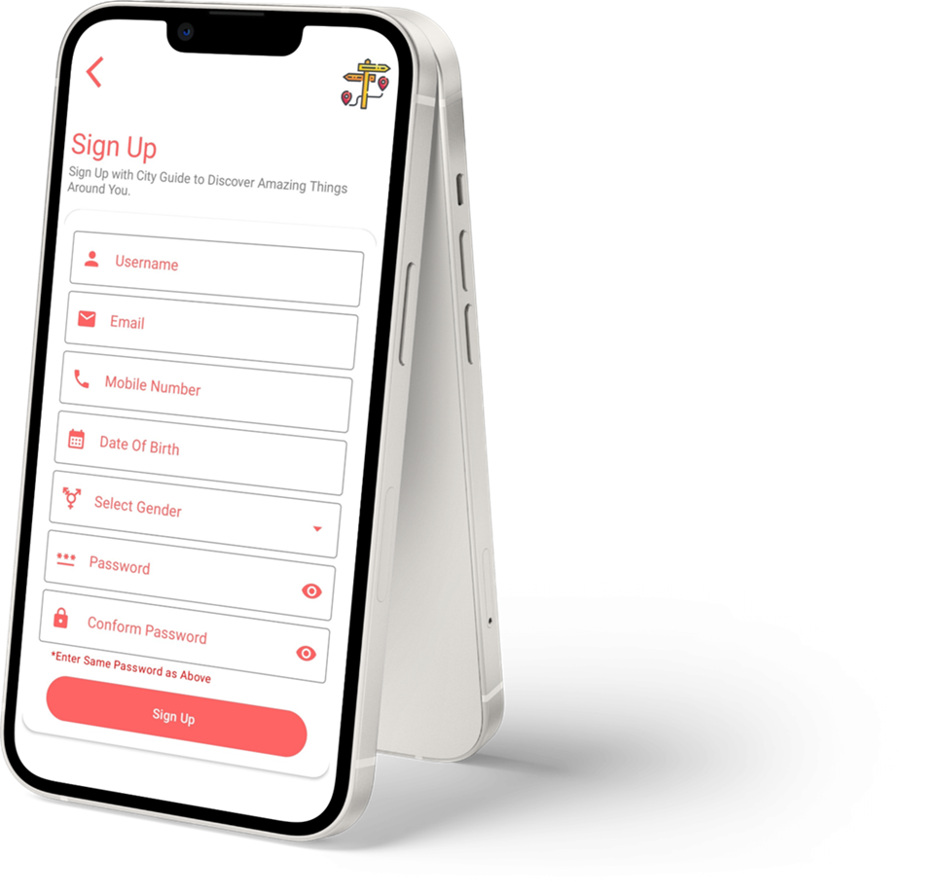

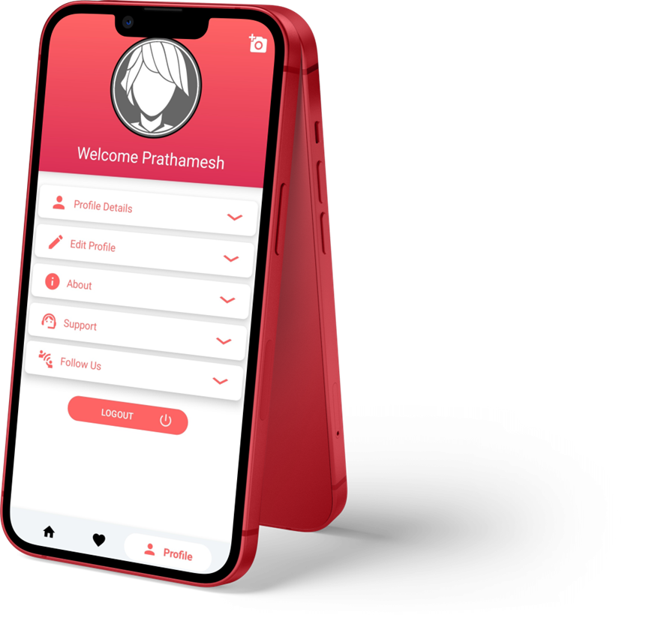
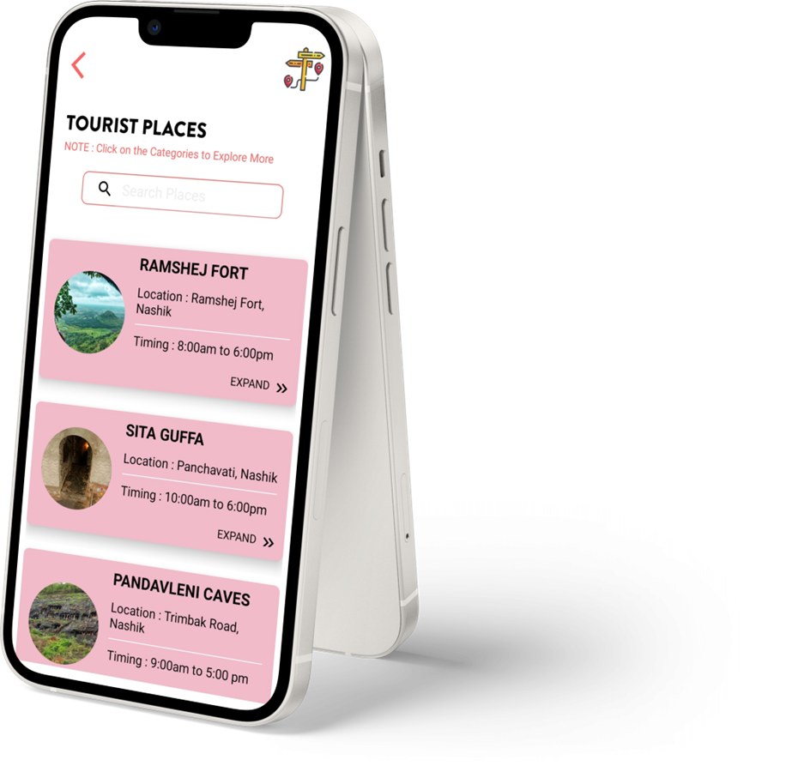
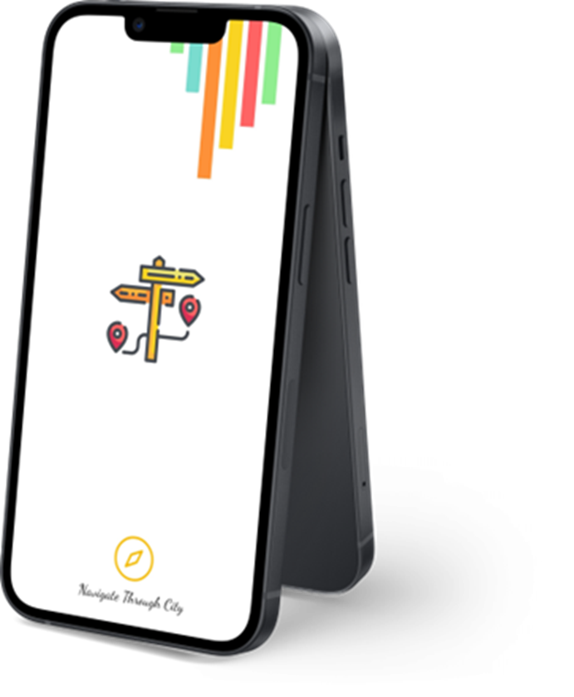
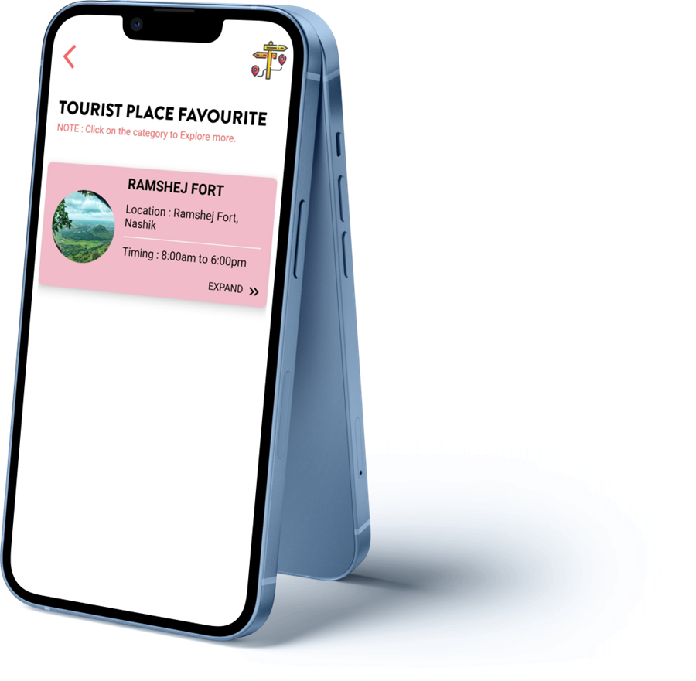
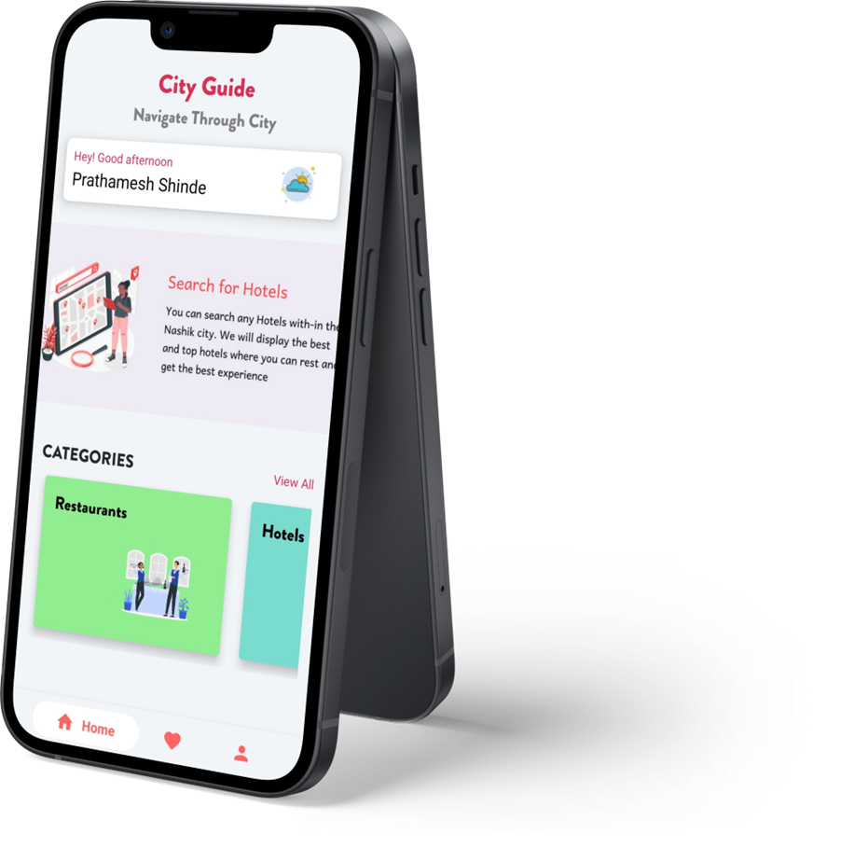
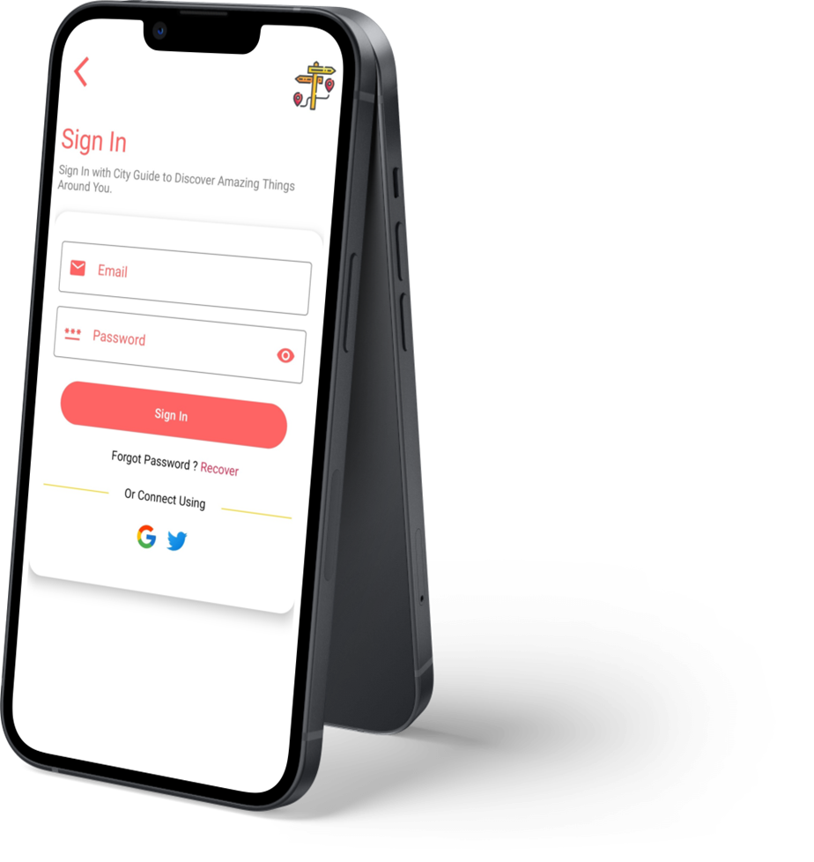
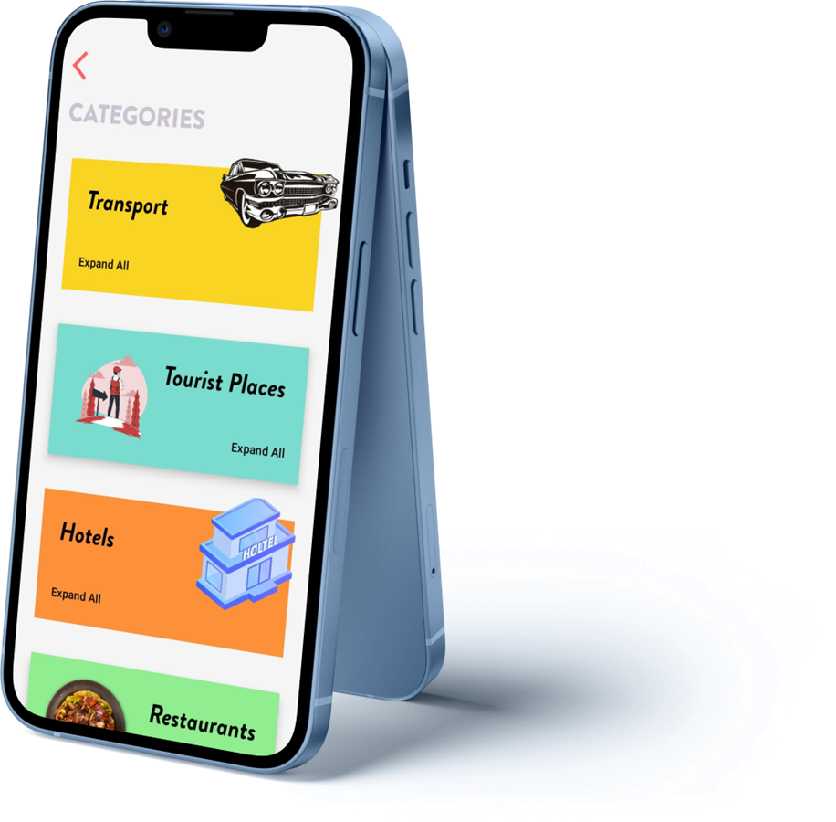
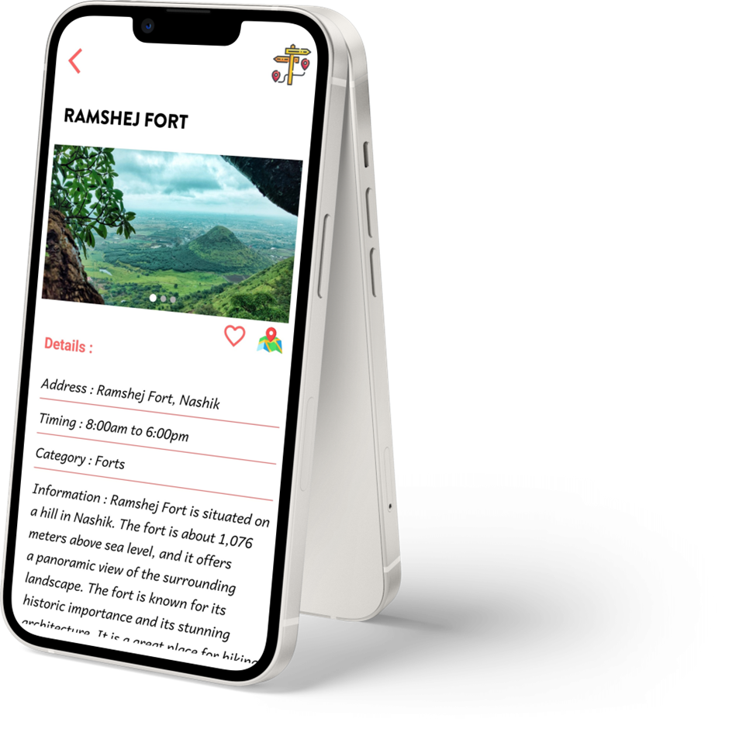
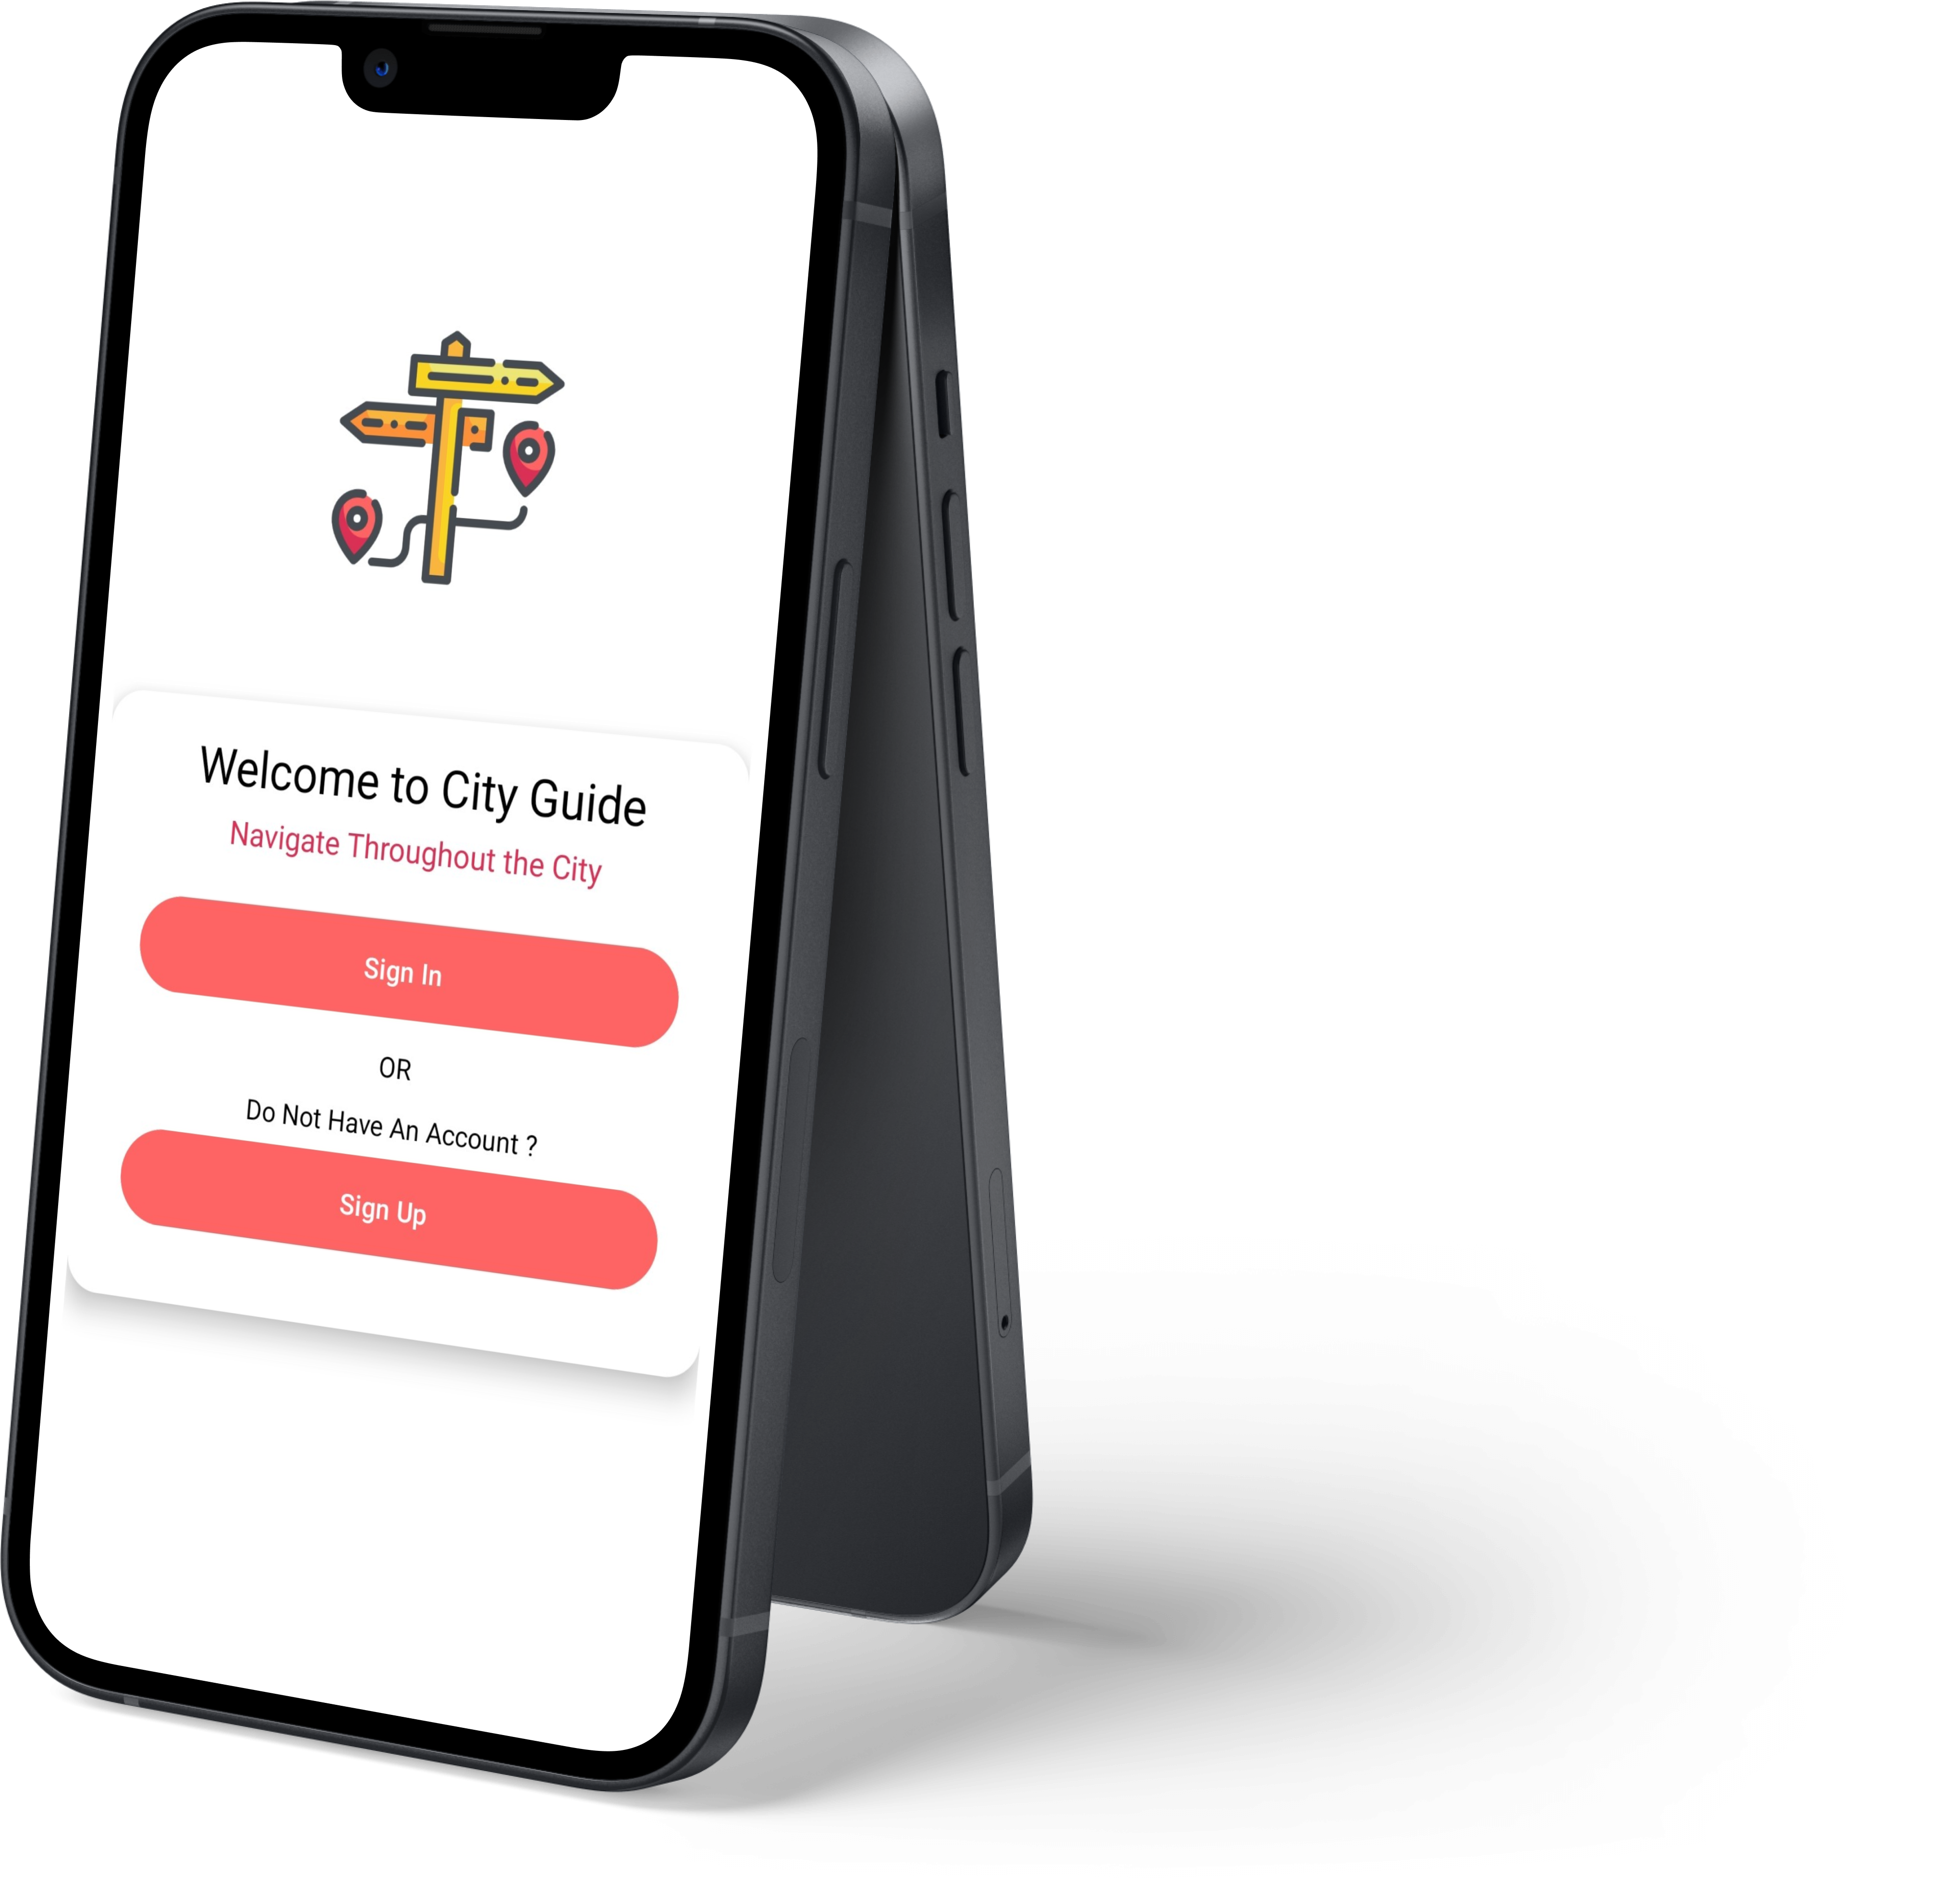
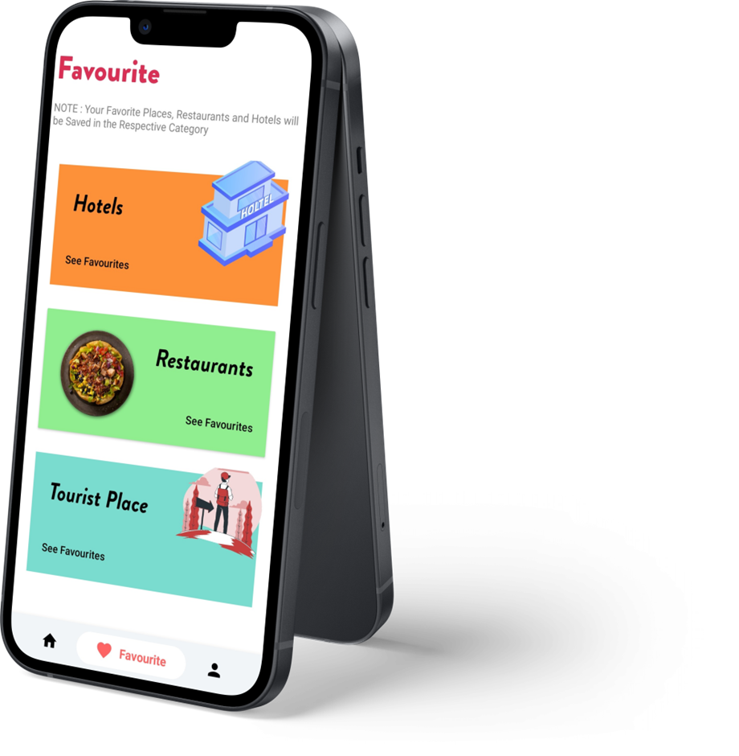
1.
WELCOM TO THE
2.
FAVORITE TOURIST-PLACE SCREEN
CATEGORIES SCREEN
FAVORITES SCREEN
PROFILE SCREEN
TOURIST-PLACE INFO. SCREEN
SPLASH SCREEN
TOURIST-PLACE SCREEN
DASHBOARD SCREEN
SIGN-IN SCREEN
SIGN-UP SCREEN
SIGN-IN & SIGN-UP SCREEN
3.
4.
1. Categories Screen
1. Sign-In Button
1. Animated Initial Screen
5.
1. Screen To Display User’s Favorite Places
1. Image Slider to display images
1. Sign-In Button
1. Tourist-Places Recycler View
1. Greetings With Username
1. Categories In Favorite Section
1. Registration Form
1. User’s Profile Screen
6. Contact Us Section
6.
“CITY GUIDE”
2. Recover password Button
2. Profile Details Section
7. LOGOUT Button
2. Favorite Button
2. Image Slider With App Info.
2. Search Bar
2. Sign-Un Button
7.
2. Sign-Up Button
3. Edit Profile Section
3. Gmail Sign-In Button
8.
3. Location Link
3. Categories Slider
Created By-
Prathamesh Shinde
Krushna Shinde
Parth Kokil
4. About Section
9.
With Guidance Of-
Prof. Jyoti Mahatme Mam
4. Tourist-Place Information
4. Twitter Sign-In Button
10.
5. Support Section
11.

Slide 2
1.
2.
FAVORITE TOURIST-PLACE SCREEN
CATEGORIES SCREEN
SPLASH SCREEN
FAVORITES SCREEN
PROFILE SCREEN
TOURIST-PLACE INFO. SCREEN
TOURIST-PLACE SCREEN
DASHBOARD SCREEN
SIGN-IN SCREEN
SIGN-UP SCREEN
SIGN-IN & SIGN-UP SCREEN
3.
4.
1. Categories Screen
1. Sign-In Button
5.
1. Screen To Display User’s Favorite Places
1. Animated Initial Screen
1. Image Slider to display images
1. Sign-In Button
1. Tourist-Places Recycler View
1. Greetings With Username
1. Categories In Favorite Section
1. Registration Form
1. User’s Profile Screen
6. Contact Us Section
6.
2. Recover password Button
2. Profile Details Section
7. LOGOUT Button
2. Favorite Button
2. Image Slider With App Info.
2. Search Bar
2. Sign-Un Button
7.
2. Sign-Up Button
3. Edit Profile Section
3. Gmail Sign-In Button
8.
3. Location Link
3. Categories Slider
4. About Section
9.
4. Tourist-Place Information
4. Twitter Sign-In Button
10.
5. Support Section
11.

Slide 3
1.
2.
FAVORITE TOURIST-PLACE SCREEN
SIGN-IN & SIGN-UP SCREEN
CATEGORIES SCREEN
FAVORITES SCREEN
PROFILE SCREEN
TOURIST-PLACE INFO. SCREEN
SPLASH SCREEN
TOURIST-PLACE SCREEN
DASHBOARD SCREEN
SIGN-IN SCREEN
SIGN-UP SCREEN
3.
4.
1. Categories Screen
1. Sign-In Button
5.
1. Sign-In Button
1. Screen To Display User’s Favorite Places
1. Image Slider to display images
1. Animated Initial Screen
1. Tourist-Places Recycler View
1. Greetings With Username
1. Categories In Favorite Section
1. Registration Form
1. User’s Profile Screen
6. Contact Us Section
6.
2. Recover password Button
2. Profile Details Section
7. LOGOUT Button
2. Favorite Button
2. Image Slider With App Info.
2. Sign-Un Button
2. Search Bar
2. Sign-Up Button
7.
3. Edit Profile Section
3. Gmail Sign-In Button
8.
3. Location Link
3. Categories Slider
4. About Section
9.
4. Tourist-Place Information
4. Twitter Sign-In Button
10.
5. Support Section
11.

Slide 4
1.
SIGN-UP SCREEN
2.
FAVORITE TOURIST-PLACE SCREEN
SIGN-IN & SIGN-UP SCREEN
CATEGORIES SCREEN
FAVORITES SCREEN
PROFILE SCREEN
TOURIST-PLACE INFO. SCREEN
TOURIST-PLACE SCREEN
SPLASH SCREEN
DASHBOARD SCREEN
SIGN-IN SCREEN
3.
4.
1. Registration Form
1. Categories Screen
1. Sign-In Button
5.
1. Sign-In Button
1. Screen To Display User’s Favorite Places
1. Image Slider to display images
1. Animated Initial Screen
1. Categories In Favorite Section
1. Tourist-Places Recycler View
1. Greetings With Username
1. User’s Profile Screen
6. Contact Us Section
6.
2. Recover password Button
2. Profile Details Section
7. LOGOUT Button
2. Favorite Button
2. Image Slider With App Info.
2. Sign-Up Button
2. Search Bar
7.
2. Sign-Un Button
3. Edit Profile Section
3. Gmail Sign-In Button
8.
3. Location Link
3. Categories Slider
4. About Section
9.
4. Tourist-Place Information
4. Twitter Sign-In Button
10.
5. Support Section
11.

Slide 5
1.
SIGN-UP SCREEN
2.
FAVORITE TOURIST-PLACE SCREEN
SIGN-IN & SIGN-UP SCREEN
CATEGORIES SCREEN
SIGN-IN SCREEN
FAVORITES SCREEN
PROFILE SCREEN
TOURIST-PLACE INFO. SCREEN
SPLASH SCREEN
TOURIST-PLACE SCREEN
DASHBOARD SCREEN
3.
4.
1. Sign-In Button
1. Registration Form
1. Categories Screen
1. Sign-In Button
1. Screen To Display User’s Favorite Places
5.
1. Image Slider to display images
1. Animated Initial Screen
1. Categories In Favorite Section
1. Tourist-Places Recycler View
1. Greetings With Username
1. User’s Profile Screen
6. Contact Us Section
6.
2. Recover password Button
2. Profile Details Section
7. LOGOUT Button
2. Favorite Button
2. Sign-Up Button
2. Search Bar
2. Image Slider With App Info.
7.
2. Sign-Un Button
3. Gmail Sign-In Button
3. Edit Profile Section
8.
3. Location Link
3. Categories Slider
4. About Section
9.
4. Twitter Sign-In Button
4. Tourist-Place Information
10.
5. Support Section
11.

Slide 6
1.
SIGN-UP SCREEN
2.
FAVORITE TOURIST-PLACE SCREEN
DASHBOARD SCREEN
SIGN-IN & SIGN-UP SCREEN
CATEGORIES SCREEN
SIGN-IN SCREEN
FAVORITES SCREEN
PROFILE SCREEN
TOURIST-PLACE INFO. SCREEN
TOURIST-PLACE SCREEN
SPLASH SCREEN
3.
4.
1. Sign-In Button
1. Registration Form
1. Categories Screen
1. Greetings With Username
5.
1. Screen To Display User’s Favorite Places
1. Sign-In Button
1. Image Slider to display images
1. Animated Initial Screen
1. Categories In Favorite Section
1. Tourist-Places Recycler View
1. User’s Profile Screen
6. Contact Us Section
6.
2. Recover password Button
2. Image Slider With App Info.
2. Profile Details Section
7. LOGOUT Button
2. Favorite Button
2. Sign-Up Button
2. Search Bar
7.
2. Sign-Un Button
3. Gmail Sign-In Button
3. Edit Profile Section
8.
3. Categories Slider
3. Location Link
4. About Section
9.
4. Twitter Sign-In Button
4. Tourist-Place Information
10.
5. Support Section
11.

Slide 7
1.
SIGN-UP SCREEN
2.
DASHBOARD SCREEN
FAVORITE TOURIST-PLACE SCREEN
CATEGORIES SCREEN
SIGN-IN & SIGN-UP SCREEN
FAVORITES SCREEN
SIGN-IN SCREEN
PROFILE SCREEN
TOURIST-PLACE INFO. SCREEN
SPLASH SCREEN
TOURIST-PLACE SCREEN
3.
4.
1. Sign-In Button
1. Registration Form
1. Categories Screen
1. Greetings With Username
5.
1. Screen To Display User’s Favorite Places
1. Sign-In Button
1. Image Slider to display images
1. Animated Initial Screen
1. Categories In Favorite Section
1. Tourist-Places Recycler View
1. User’s Profile Screen
6. Contact Us Section
2. Recover password Button
6.
2. Image Slider With App Info.
2. Profile Details Section
7. LOGOUT Button
2. Favorite Button
2. Sign-Up Button
2. Search Bar
2. Sign-Un Button
7.
3. Gmail Sign-In Button
3. Edit Profile Section
8.
3. Categories Slider
3. Location Link
4. About Section
9.
4. Twitter Sign-In Button
4. Tourist-Place Information
10.
5. Support Section
11.

Slide 8
1.
SIGN-UP SCREEN
2.
FAVORITE TOURIST-PLACE SCREEN
TOURIST-PLACE SCREEN
DASHBOARD SCREEN
CATEGORIES SCREEN
SIGN-IN & SIGN-UP SCREEN
FAVORITES SCREEN
SIGN-IN SCREEN
PROFILE SCREEN
TOURIST-PLACE INFO. SCREEN
SPLASH SCREEN
3.
4.
1. Sign-In Button
1. Registration Form
1. Categories Screen
1. Greetings With Username
5.
1. Screen To Display User’s Favorite Places
1. Sign-In Button
1. Tourist-Places Recycler View
1. Image Slider to display images
1. Animated Initial Screen
1. Categories In Favorite Section
1. User’s Profile Screen
6. Contact Us Section
2. Recover password Button
6.
2. Image Slider With App Info.
2. Profile Details Section
7. LOGOUT Button
2. Search Bar
2. Favorite Button
2. Sign-Up Button
2. Sign-Un Button
7.
3. Gmail Sign-In Button
3. Edit Profile Section
8.
3. Categories Slider
3. Location Link
4. About Section
9.
4. Twitter Sign-In Button
4. Tourist-Place Information
10.
5. Support Section
11.

Slide 9
1.
TOURIST-PLACE INFO. SCREEN
SIGN-UP SCREEN
2.
FAVORITE TOURIST-PLACE SCREEN
TOURIST-PLACE SCREEN
DASHBOARD SCREEN
CATEGORIES SCREEN
SIGN-IN & SIGN-UP SCREEN
PROFILE SCREEN
SIGN-IN SCREEN
FAVORITES SCREEN
SPLASH SCREEN
3.
4.
1. Image Slider to display images
1. Sign-In Button
1. Registration Form
1. Categories Screen
1. Greetings With Username
5.
1. Screen To Display User’s Favorite Places
1. Sign-In Button
1. Tourist-Places Recycler View
1. Categories In Favorite Section
1. Animated Initial Screen
1. User’s Profile Screen
6. Contact Us Section
2. Recover password Button
2. Favorite Button
6.
2. Image Slider With App Info.
2. Profile Details Section
7. LOGOUT Button
2. Search Bar
2. Sign-Up Button
2. Sign-Un Button
7.
3. Location Link
3. Gmail Sign-In Button
3. Edit Profile Section
3. Categories Slider
8.
4. About Section
9.
4. Tourist-Place Information
4. Twitter Sign-In Button
10.
5. Support Section
11.

Slide 10
1.
TOURIST-PLACE INFO. SCREEN
SIGN-UP SCREEN
2.
FAVORITE TOURIST-PLACE SCREEN
TOURIST-PLACE SCREEN
DASHBOARD SCREEN
CATEGORIES SCREEN
FAVORITES SCREEN
SIGN-IN & SIGN-UP SCREEN
PROFILE SCREEN
SIGN-IN SCREEN
SPLASH SCREEN
3.
4.
1. Image Slider to display images
1. Sign-In Button
1. Registration Form
1. Categories Screen
1. Categories In Favorite Section
1. Greetings With Username
5.
1. Screen To Display User’s Favorite Places
1. Sign-In Button
1. Tourist-Places Recycler View
1. Animated Initial Screen
1. User’s Profile Screen
6. Contact Us Section
2. Recover password Button
2. Favorite Button
6.
2. Image Slider With App Info.
2. Profile Details Section
7. LOGOUT Button
2. Search Bar
2. Sign-Up Button
2. Sign-Un Button
7.
3. Location Link
3. Gmail Sign-In Button
3. Edit Profile Section
3. Categories Slider
8.
4. About Section
4. Tourist-Place Information
9.
4. Twitter Sign-In Button
10.
5. Support Section
11.

Slide 11
1.
TOURIST-PLACE INFO. SCREEN
SIGN-UP SCREEN
2.
TOURIST-PLACE SCREEN
FAVORITE TOURIST-PLACE SCREEN
DASHBOARD SCREEN
CATEGORIES SCREEN
FAVORITES SCREEN
SIGN-IN & SIGN-UP SCREEN
PROFILE SCREEN
SIGN-IN SCREEN
SPLASH SCREEN
3.
4.
1. Image Slider to display images
1. Sign-In Button
1. Registration Form
1. Categories Screen
1. Categories In Favorite Section
1. Screen To Display User’s Favorite Places
1. Greetings With Username
5.
1. Sign-In Button
1. Tourist-Places Recycler View
1. Animated Initial Screen
1. User’s Profile Screen
6. Contact Us Section
2. Recover password Button
2. Favorite Button
6.
2. Image Slider With App Info.
2. Profile Details Section
7. LOGOUT Button
2. Search Bar
2. Sign-Up Button
2. Sign-Un Button
7.
3. Location Link
3. Gmail Sign-In Button
3. Edit Profile Section
3. Categories Slider
8.
4. About Section
4. Tourist-Place Information
9.
4. Twitter Sign-In Button
10.
5. Support Section
11.

Slide 12
1.
TOURIST-PLACE INFO. SCREEN
SIGN-UP SCREEN
2.
TOURIST-PLACE SCREEN
FAVORITE TOURIST-PLACE SCREEN
DASHBOARD SCREEN
CATEGORIES SCREEN
FAVORITES SCREEN
SIGN-IN & SIGN-UP SCREEN
SIGN-IN SCREEN
PROFILE SCREEN
SPLASH SCREEN
3.
4.
1. Image Slider to display images
1. Sign-In Button
1. Registration Form
1. Categories Screen
1. Categories In Favorite Section
1. Screen To Display User’s Favorite Places
1. Greetings With Username
5.
1. Sign-In Button
1. Tourist-Places Recycler View
1. Animated Initial Screen
1. User’s Profile Screen
6. Contact Us Section
2. Recover password Button
2. Favorite Button
6.
2. Image Slider With App Info.
2. Profile Details Section
7. LOGOUT Button
2. Search Bar
2. Sign-Up Button
2. Sign-Un Button
7.
3. Location Link
3. Gmail Sign-In Button
3. Edit Profile Section
3. Categories Slider
8.
4. About Section
4. Tourist-Place Information
9.
4. Twitter Sign-In Button
10.
5. Support Section
11.

Slide 13
1.
TOURIST-PLACE INFO. SCREEN
SIGN-UP SCREEN
2.
TOURIST-PLACE SCREEN
FAVORITE TOURIST-PLACE SCREEN
DASHBOARD SCREEN
CATEGORIES SCREEN
FAVORITES SCREEN
SIGN-IN & SIGN-UP SCREEN
SIGN-IN SCREEN
PROFILE SCREEN
SPLASH SCREEN
3.
4.
1. Image Slider to display images
1. Sign-In Button
1. Registration Form
Thank You
1. Categories Screen
1. Categories In Favorite Section
1. Screen To Display User’s Favorite Places
1. Greetings With Username
5.
1. Sign-In Button
1. Tourist-Places Recycler View
1. Animated Initial Screen
1. User’s Profile Screen
6. Contact Us Section
2. Recover password Button
2. Favorite Button
6.
2. Image Slider With App Info.
2. Profile Details Section
7. LOGOUT Button
2. Search Bar
2. Sign-Up Button
2. Sign-Un Button
7.
3. Location Link
3. Gmail Sign-In Button
3. Edit Profile Section
3. Categories Slider
8.
4. About Section
4. Tourist-Place Information
9.
4. Twitter Sign-In Button
10.
5. Support Section
11.

